Slide 1
AUTOMOBILES SALES ANALYSIS
NAME: DEEPAK V
REGISTER NO: 312207281
DEPARTMENT: COMMERCE
COLLEGE: CKNC

Slide 2

AUTOMOBILES SALES ANALYSIS BY USING MICRO SOFT EXCEL

Slide 3
AGENDA:
Problem statement
Project overview
Identify key sales drivers
Analyze sales trends
Forecast sales
Result
Conclusion

Slide 4
PROBLEM STATEMENT:
The automobiles industry is highly competitive and influenced by various factors such as economic conditions, consumer preferences, and technologies and advancements. Despite the potential for growth, many automobiles companies face challenges in predicting sales trends, identifying key drivers of sales, and making date-driven decisions to optimize inventory, pricing and marketing.

Slide 5
PROJECT OVERVIEW:
our project aims to analyse the overall sales of cars in automobiles industry.
We seek accurately the sales ration of the automobiles industry.
The excel will expose the sales ration of the cars.

Slide 6
IDENTIFY KEY SALES DRIVERS:
Determine the factors that significantly impact automobiles sales, such as vehicle type, price, economic indicators, and consumer demographics. The main factors of sales are follows:
Economic conditions
Consumer preferences
Market trends

Slide 7
ANALYZE SALES TRENDS:
Understand historical sales trends across different regions, time periods, and vehicle categories to predict future sales performance. Here’s how you can approach the analysis:
Time series analysis
Segment-wise analysis
Economic impact
Consumer landscape
Consumer behaviour trends
Competitive landscape
Regulatory and policy changes
Pandemic impact

Slide 8
FORECAST SALES:
Develop predictive models to forecast future sales based on historical data and market conditions

Slide 9
MARKET SHARE ANALYSIS:
OBJECTIVE:
determine the market share of different brands and vehicle types over time.
APPROACH:
1.calculate each brands percentage of total sales in a given period.
2. compare market share across different regions or countries.

Slide 10
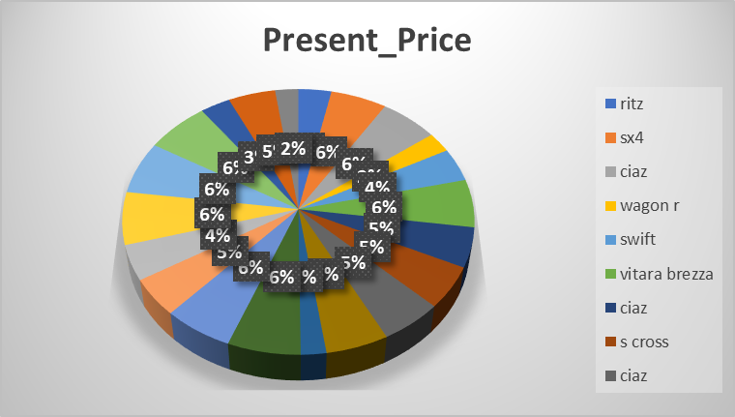
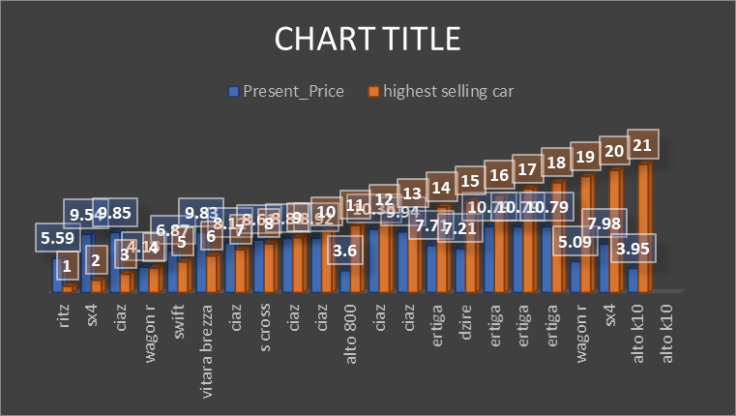
RESULT:

Slide 11
CONCLUSION:
By analysing these sales trend, companies can gain valuable insights into market dynamics, allowing them to make informed decisions on inventory management, market strategies, product development, and overall business planning.

Slide 12
THANK YOU!

